Slide 1
Alzheimer’s disease.
01
02
Dynamic system.
Ca²⁺ & Memantine
03
04
Conclusion

Slide 2
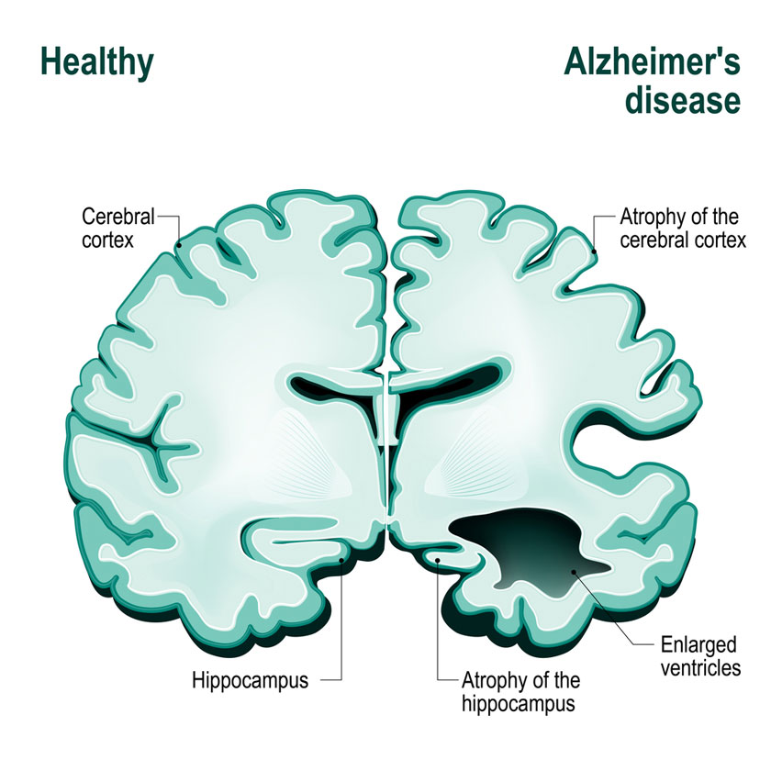
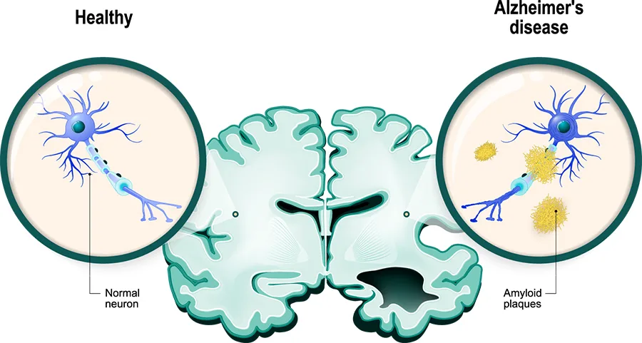
Alzheimer’s disease
Alzheimer’s disease is a progressive neurodegenerative disorder characterized by the gradual loss of memory, cognitive functions, and behavioral abilities. It’s the most common cause of dementia in older adults.

Slide 3
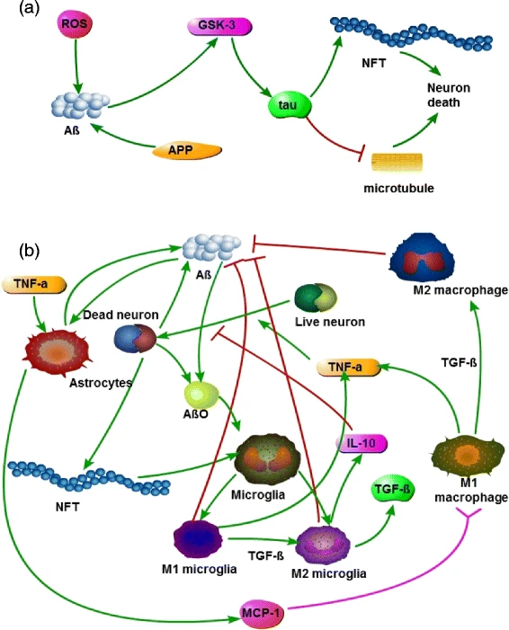
Key biological hallmarks:
Amyloid-β (Aβ) plaques
Neurofibrillary tangles
Neuronal loss and synaptic dysfunction
Neuroinflammation and oxidative stress

Slide 4
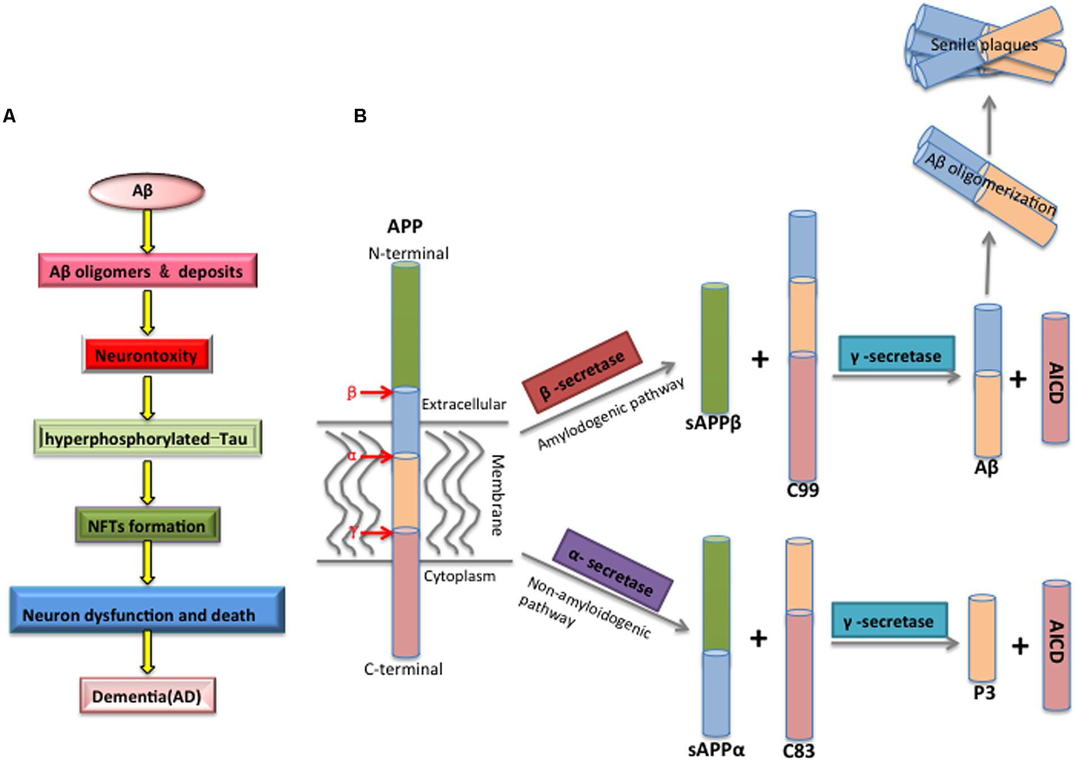
Aβ
Peptide from APP cleavage (β- & γ-secretases)
Aggregates → oligomers & plaques
Key trigger in Alzheimer’s pathology
Imbalance between production & clearance

Slide 5
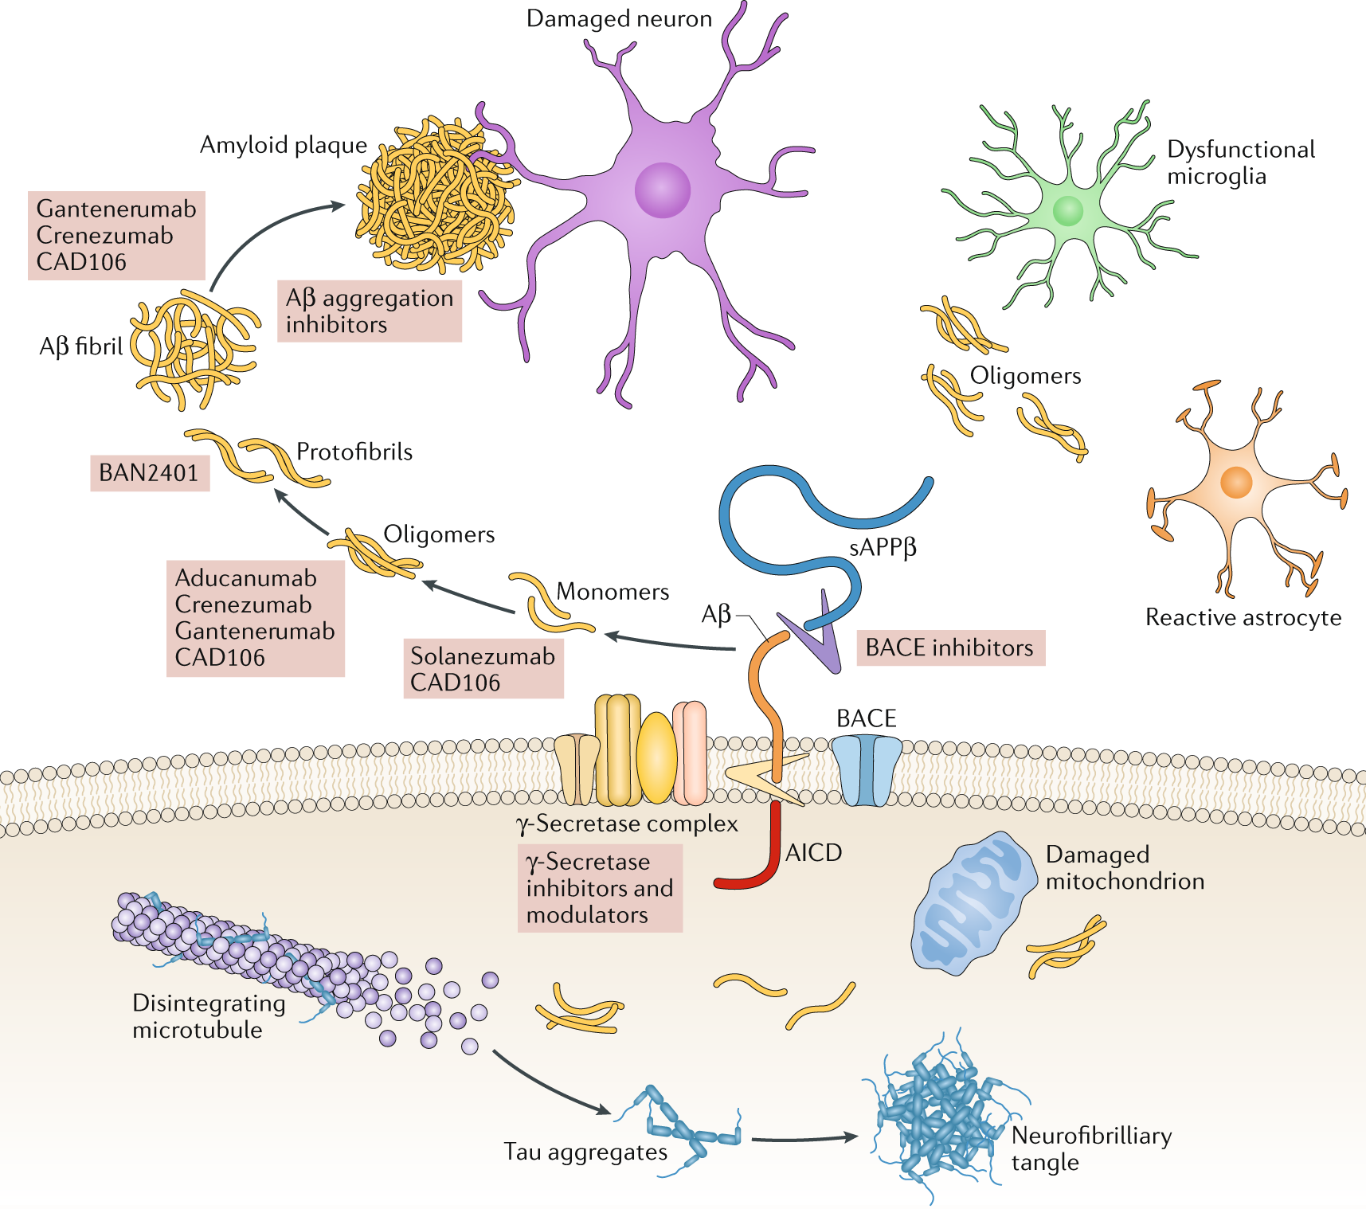
Dynamic system
The extracellular amyloid- β
01
02
03
The intracellular amyloid- β
Amyloid- β
oligomers

Slide 6
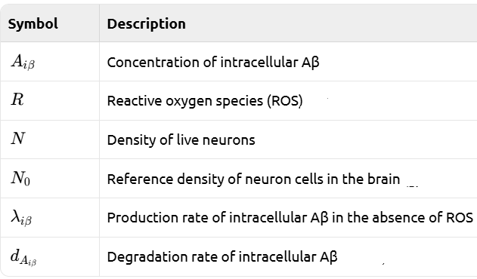
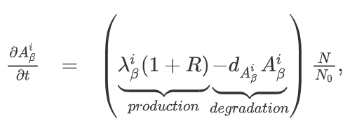
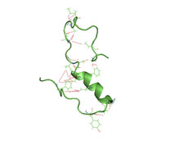
The intracellular amyloid- β

Slide 7
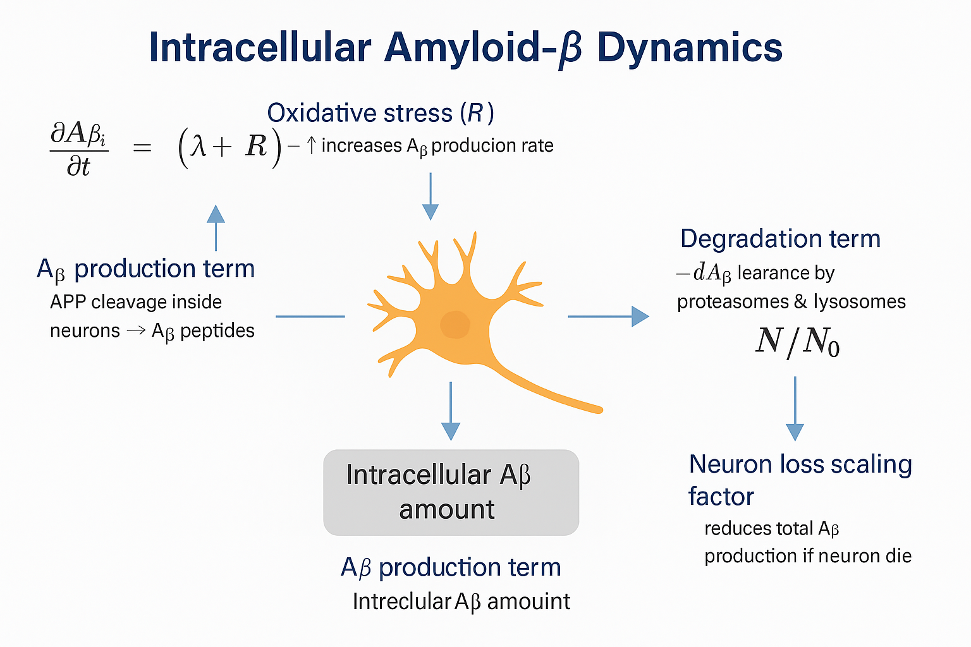

Slide 8
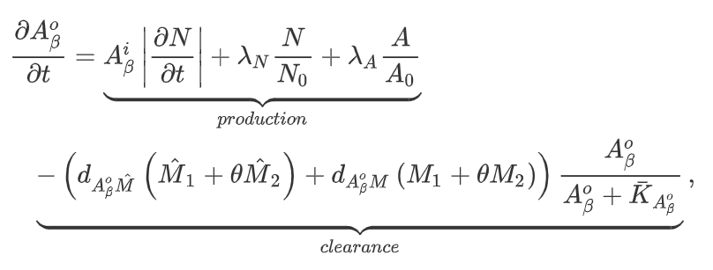
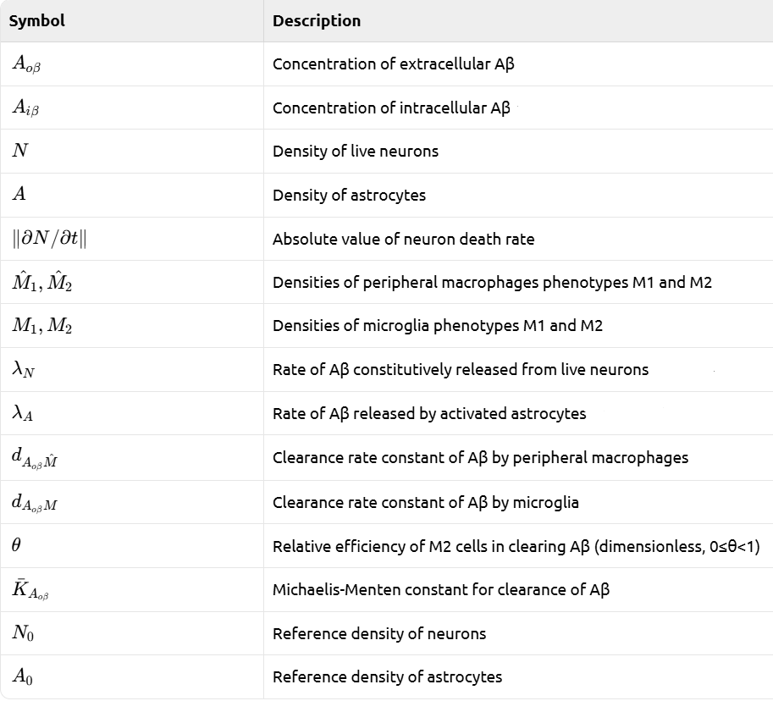
The extracellular amyloid- β

Slide 9
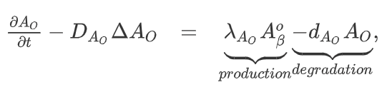
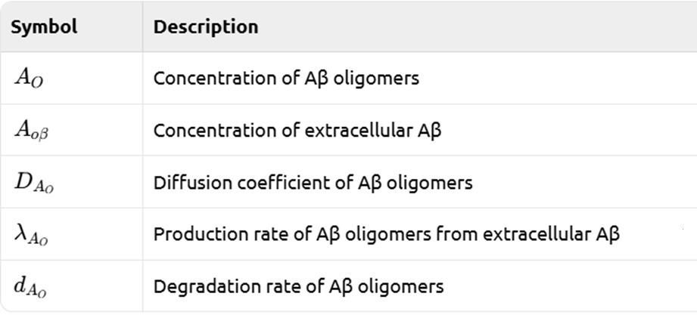
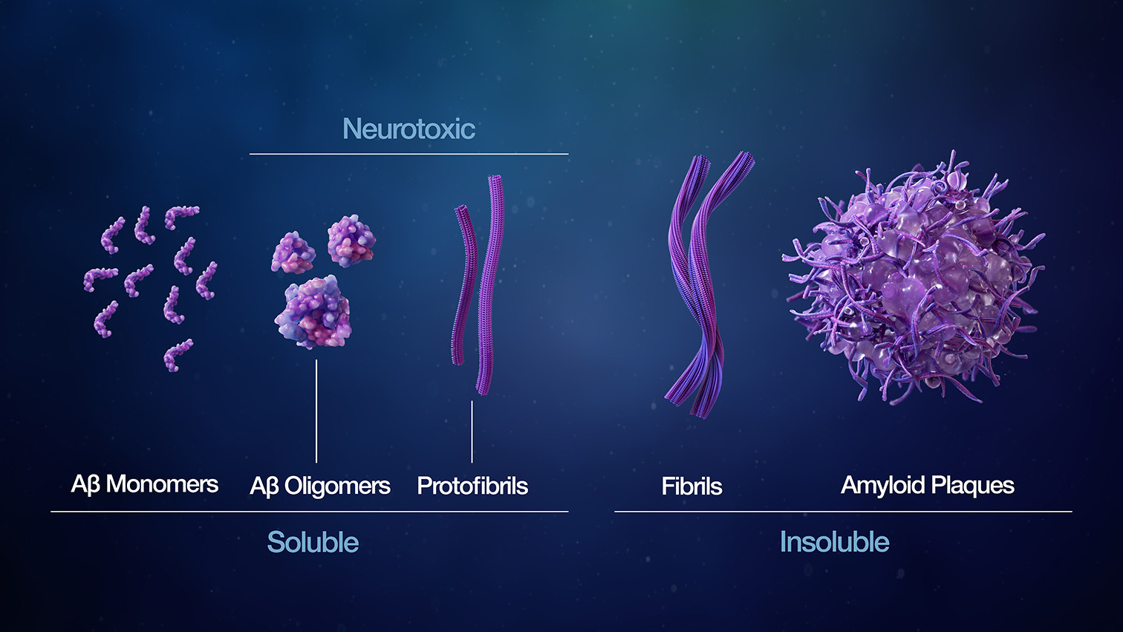
The Amyloid- β oligomers

Slide 10
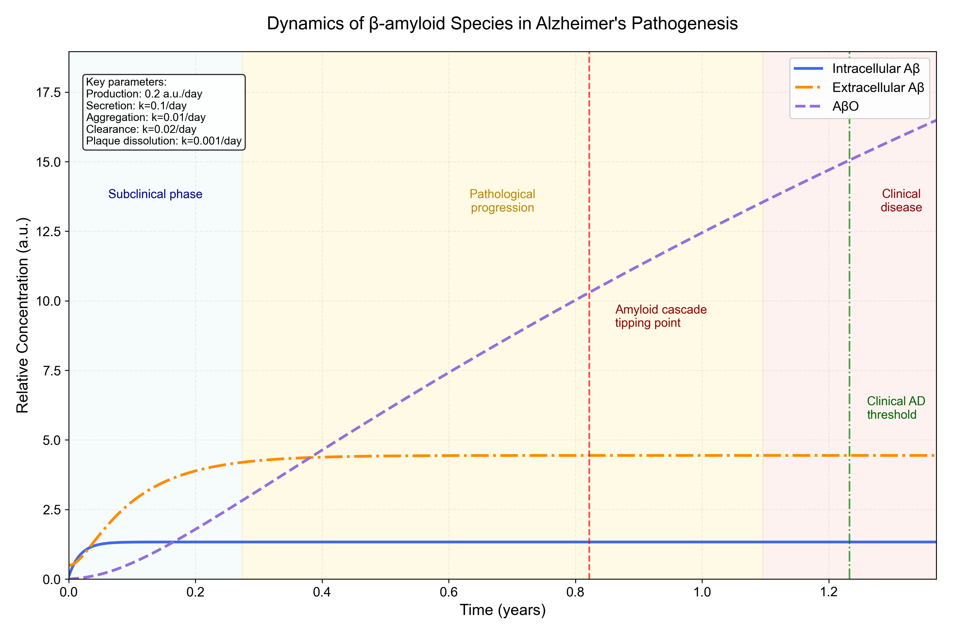

Slide 11
The influence of Ca²⁺
Aβ
Lysosome-Autophagy
Clearance
Slow down the autophagy progress
Mess up lysosome function
Ca²⁺ homeostasis
interaction
A vicious cycle
Aggregation to form oligomers
BACE1
+
γ-secretase
ROS
The amyloidogenic pathway
Produce two toxic peptides
Aβ42 and Aβ40
Excitotoxic cycle
Promote the β-cleavage pathway
Abnormal NMDA activation

Slide 12
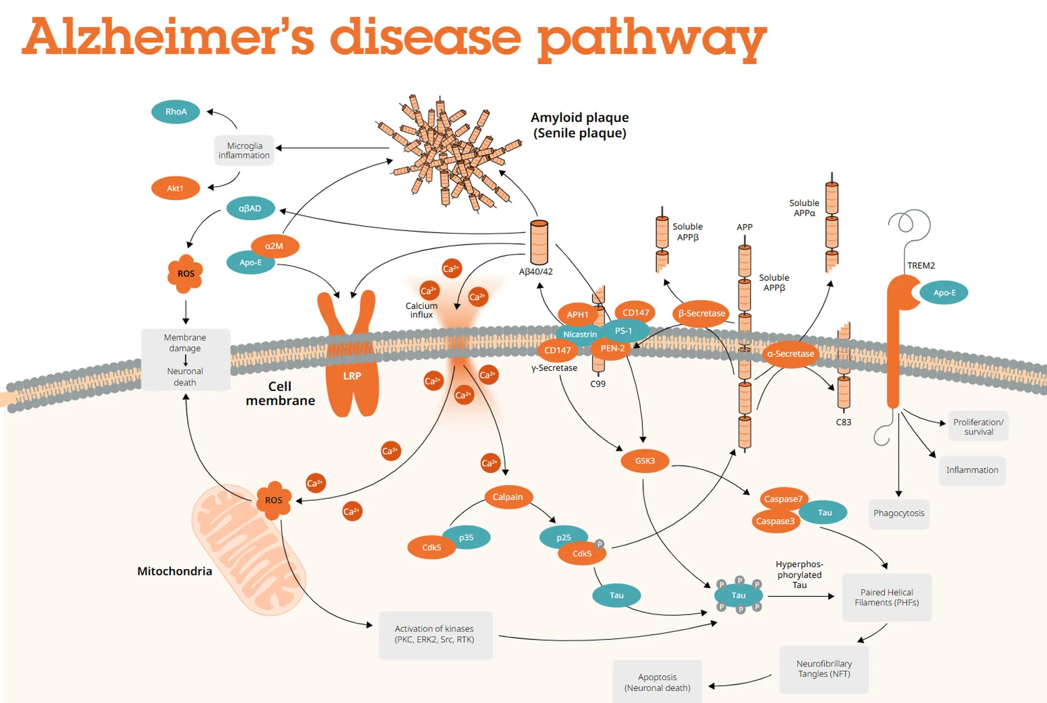
The influence of Ca²⁺

Slide 13
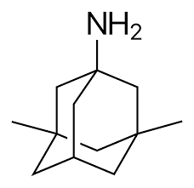
Memantine

Slide 14
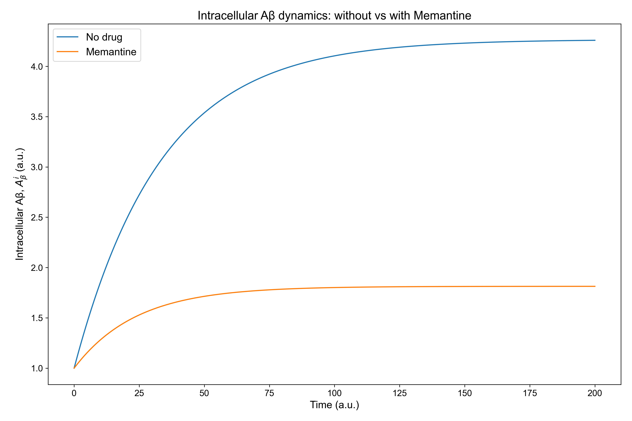

Slide 15
Conclusion
Mathematical modeling helps us quantify how extracellular, intracellular, and oligomeric amyloid-β interact and evolve over time.
The equations reveal how imbalances in production or clearance can lead to toxic accumulation — reflecting the mechanisms of Alzheimer’s progression.By changing parameters, we can simulate therapeutic scenarios, such as enhancing clearance or blocking oligomerization.
This approach provides a predictive framework to test biological hypotheses and identify the most effective intervention points.
Overall, modeling amyloid-β dynamics helps bridge experimental biology with therapeutic strategy design for Alzheimer’s disease.

